Slide 1

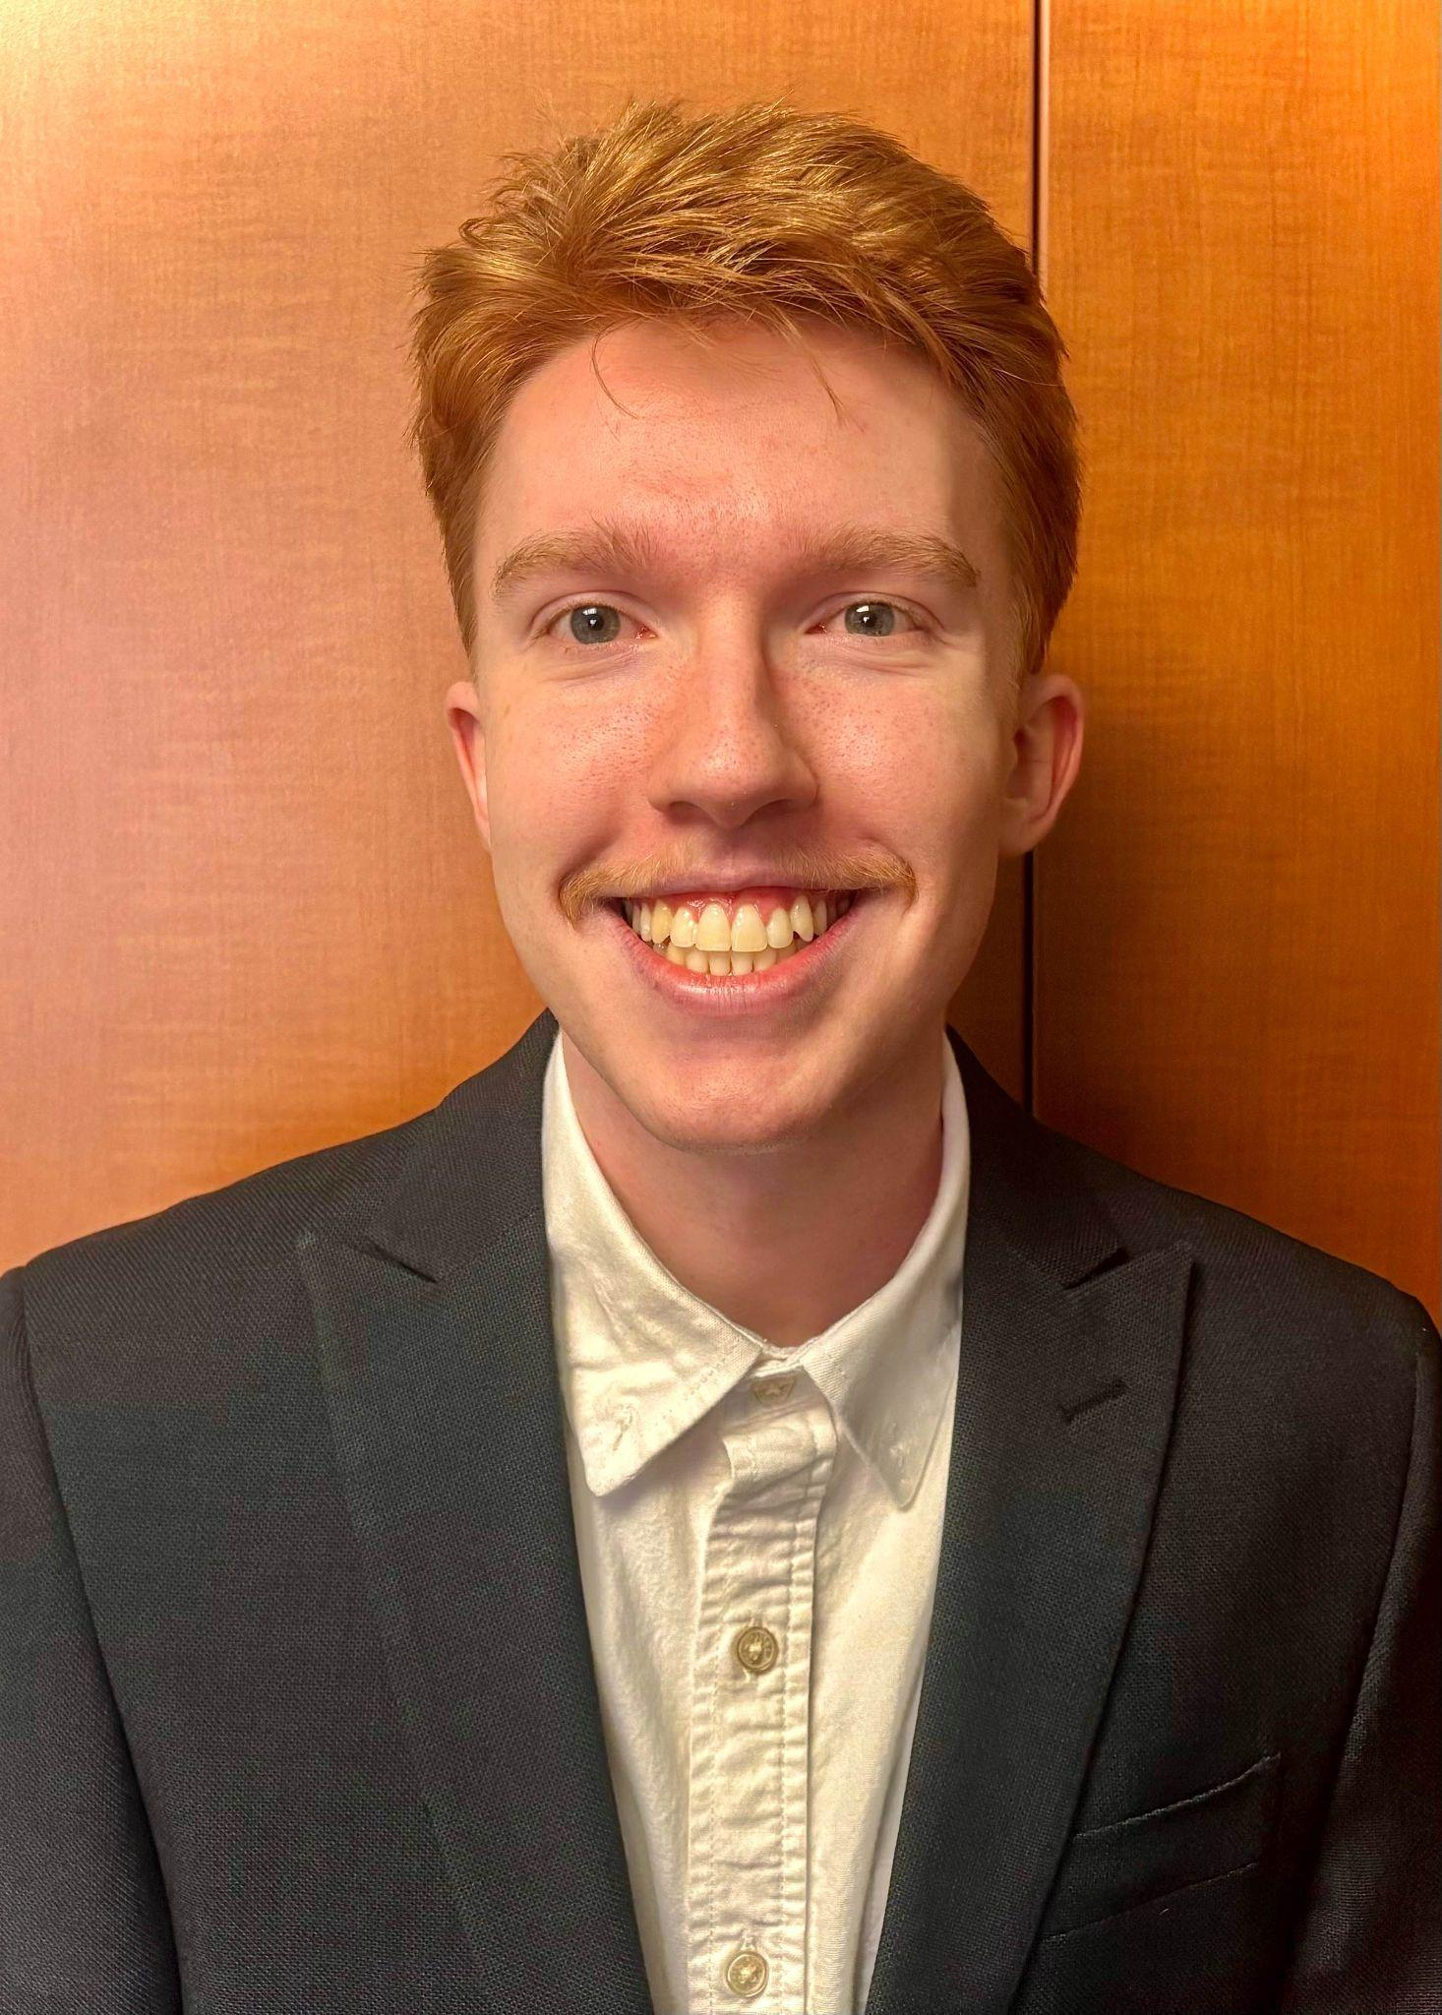
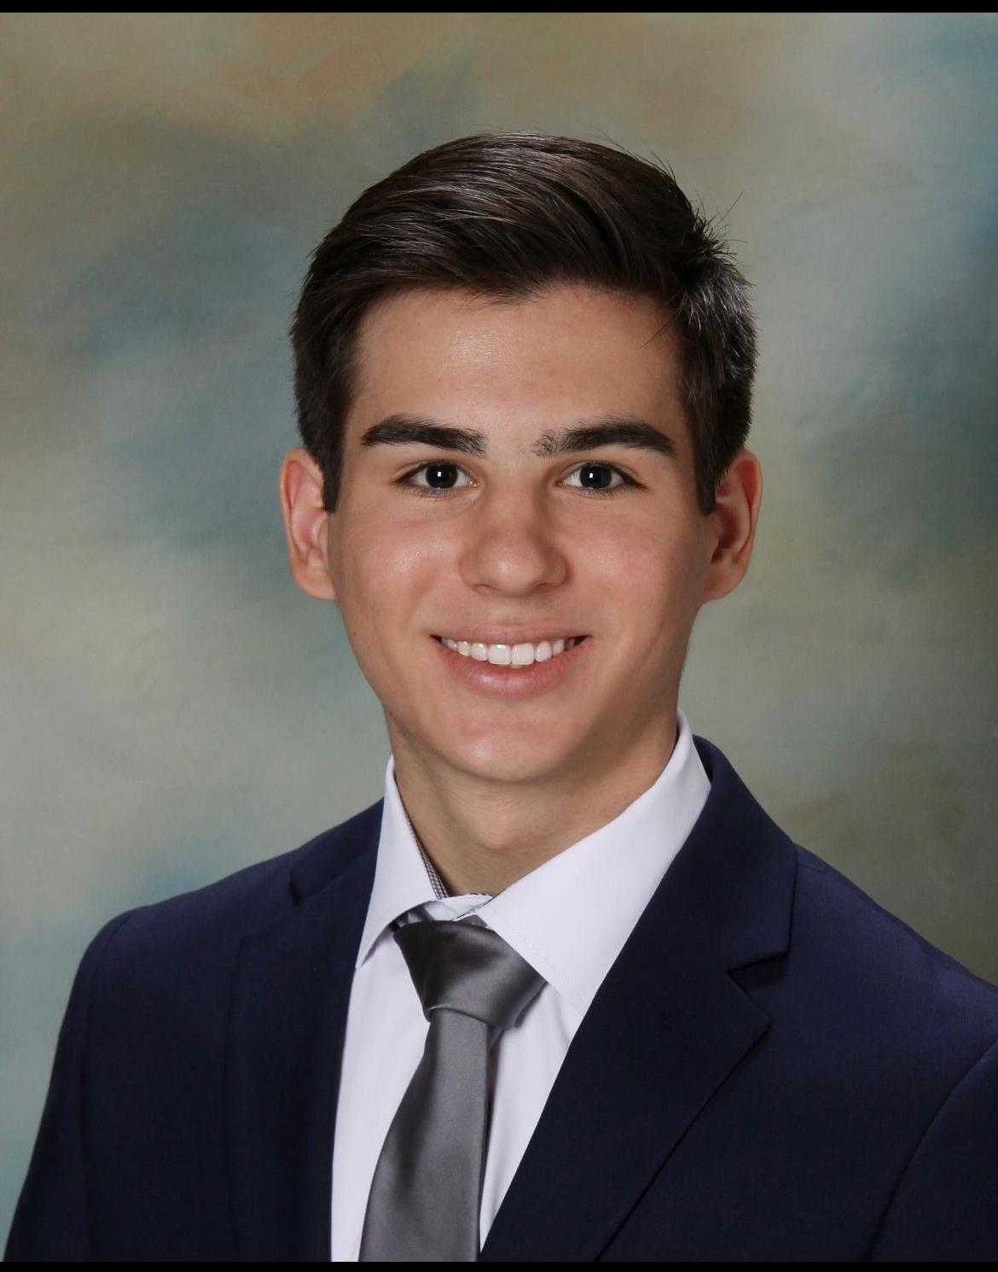
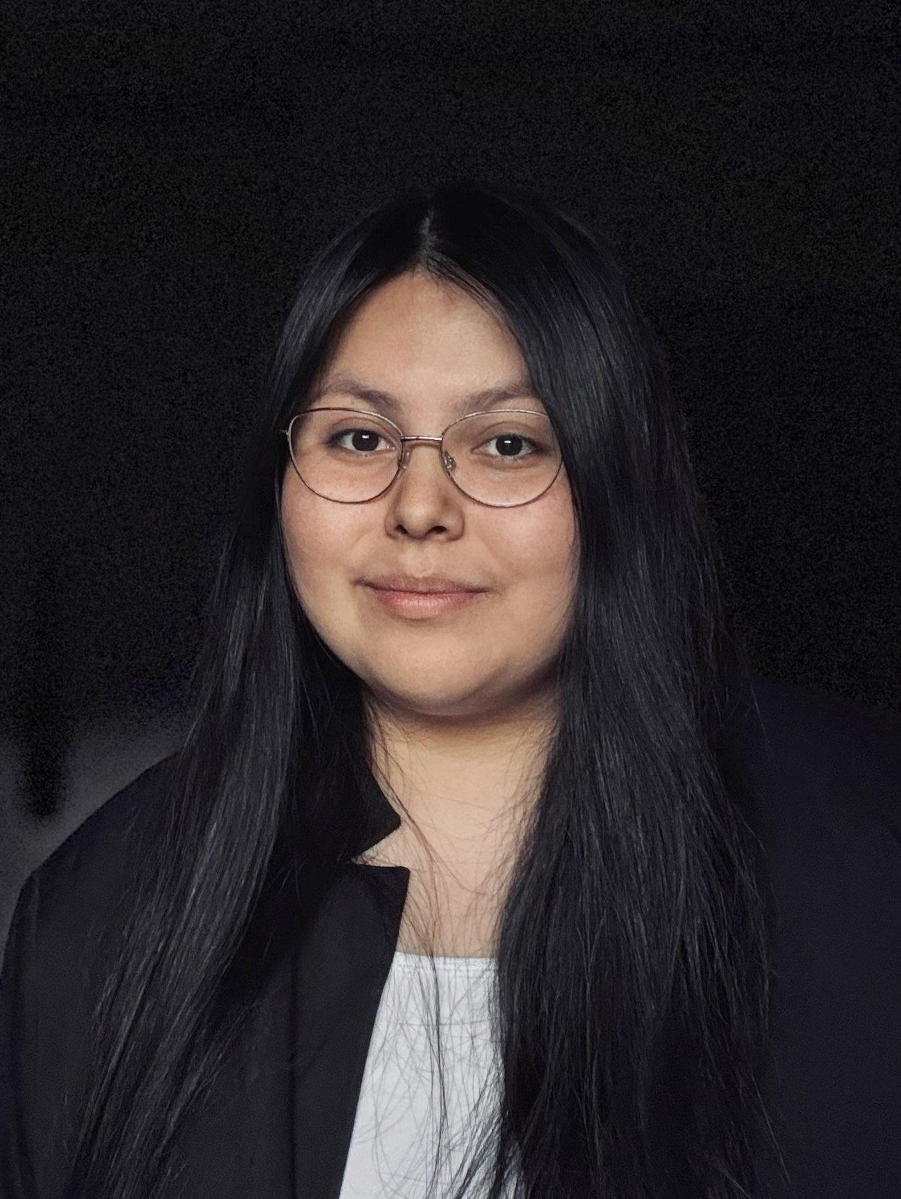
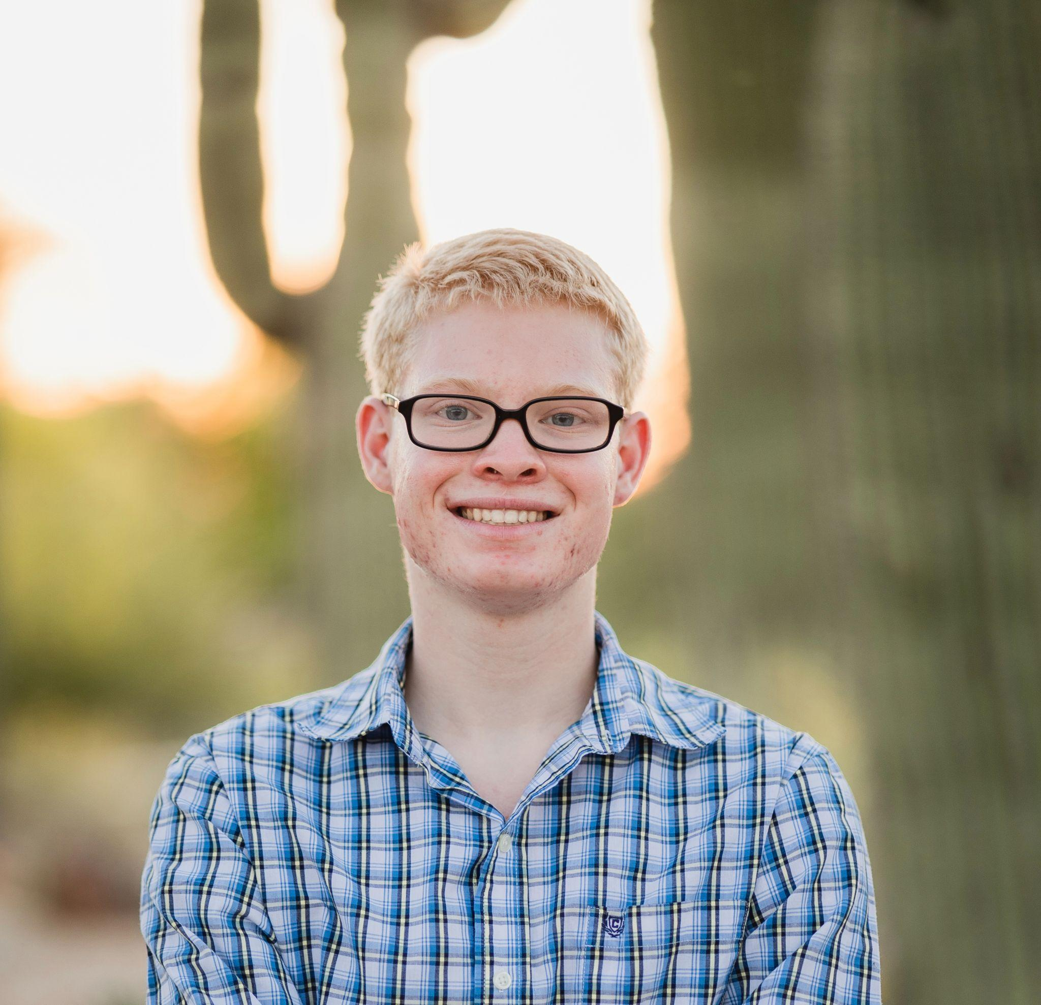
KIMinder360 Team
Team Mentor: Md Nazmul Hossain
Dylan Hyer
Team Leader
deh277@nau.edu
Nyle Huntley
Release Manager
nah353@nau.edu
Cole Bishop
Recorder
cdb499@nau.edu
Mayanna John
Architect
mrj335@nau.edu

Slide 2

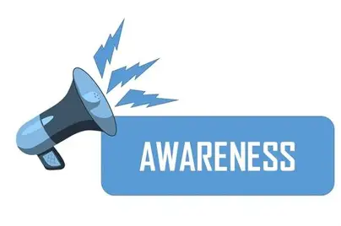
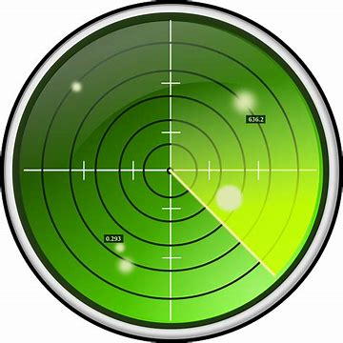
Introduction
KIMinder360 aims to improve situational awareness
A collection of directives that encourage Mindfulness
Become more prepared and present through practice
Notes:
How would you feel if you were only experiencing a fraction of your life? Well most people are.
They live their lives on autopilot, paying no attention to their surroundings.
KIMinder360 is all about practicing situational awareness every day to train yourself into being more aware.
It does this by periodically handing out directives that encourage people to pay more attention to what's around them.
Through this process it allows you to live your life to the fullest.

Slide 3
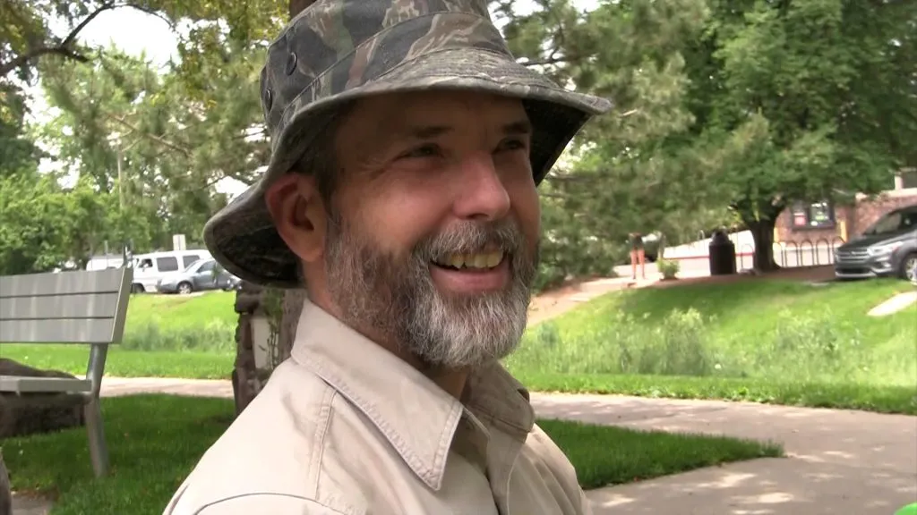
Who Is Morgan Boatman?
Worked with Marines
Entrepreneur
NAU capstone sponsor
This is our client Morgan Boatman
Notes:
Morgan has had many entrepreneurial endeavors throughout the years. He has many wonderful ideas related to both teamwork and situational awareness He also has other capstone projects.

Slide 4

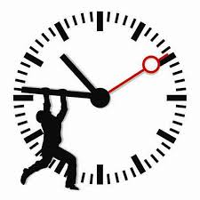
Pain Points in the Previous Setup
Unautomated
Limited Access
Limited Directive Personalization
Time Consuming
Notes:
Unautomated - Morgan used to call people and hand out directives manually.
Limited access- People only has access to this if they found morgans website or knew him personally.
Limited prompt choices - People didn’t have the ability to choose their own settings for prompt categories.
Untimely - Morgan found himself in a situation where he had this idea but didn’t have the time to actually implement it.

Slide 5
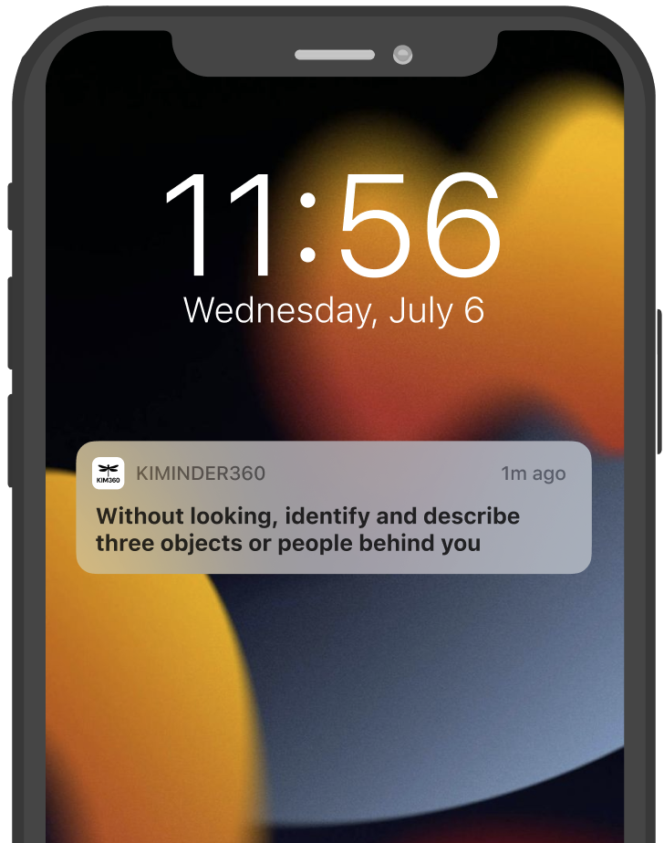
Our Solution: KIMinder360 App
Automated directive reminders
Flexible directive categories and reminder frequencies
Hours of manual effort eliminated
Training made accessible to everyone
Notes:
Instead of Morgan having to make individual phone calls, our proposed app will automatically send directives straight to users’ phones at customizable intervals. They can simply download the app and choose the categories of directives and reminder frequencies that work for them. This not only saves hours of manual effort on Morgan’s end with automation but also makes situational awareness training far more accessible and scalable than ever. Morgan’s reach used to be limited by the number of calls he could make in a day, but with KIMinder360 that limitation disappears. Anybody with a phone can join instantly, creating virtually unlimited potential for user base growth.

Slide 6



Plan for Development
Weekly Meetings
UI
Notifications
Secure backend
Scalability
User testing

Slide 7
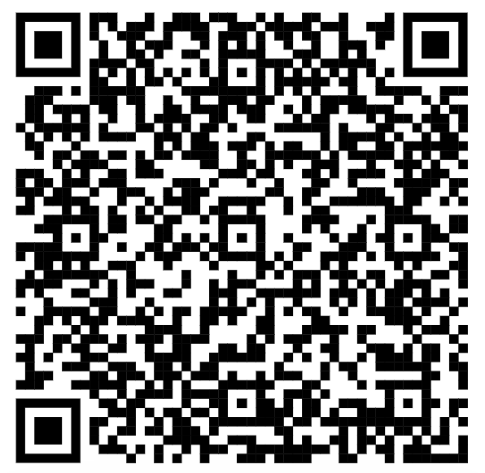
Conclusion
KIMinder360 Team
Please Contact us with any Questions!
Our Website!
Dylan Hyer
deh277@nau.edu
Nyle Huntley
nah353@nau.edu
Cole Bishop
cdb499@nau.edu
Mayanna John
mrj335@nau.edu
Notes:
In summary, as the KIMinder360 Team we are going to build a mobile application that automates the process of handing out mindfulness directives to users on behalf of our client Morgan Boatman so that he can dramatically improve his efficiency.

